Slide 1
ELEMENTARY STATISTICS, BLUMAN
Multiplication Rule 1 Independent Events
© 2019 McGraw-Hill Education. All rights reserved. Authorized only for instructor use in the classroom. No reproduction or further distribution permitted without the prior written consent of McGraw-Hill Education.

Slide 2
Objectives for this PowerPoint
How to determine whether two events are Independent Events
How to apply the Multiplication Rule for Independent Events

Slide 3
Example
Statista Motors builds 2 models of cars, the Regressa and the Devion. Seventy percent of the company’s customers purchase the Regressa and thirty percent purchase the Devion. In an effort to increase revenue, the company has recently changed the floor mat policy so that floor mats are no longer standard equipment. Since the policy change the company has found that twenty percent of those who purchase a Statista also order floor mats. They have also found that sixty percent of those who purchase the Devion also order floor mats. The marketing manager would like to determine the probability that a randomly selected customer will purchase a Devion with floor mats.

Slide 4
Independent Events
Two Events A and B are independent events if the fact that A occurs does not affect the probability of B occurring.
In our example, we are told that both types of mats are equally likely to be selected regardless of which model is purchased. The probability that an All-Weather mat would be selected is .5
P(All-Weather) = 0.5
This also means that the conditional probability that All-Weather mats would be selected given the customer purchased a Regressa is also equal to .5.
The symbol “l” represents “Given that”
P(All-Weather l Regressa) = 0.5

Slide 5

Examples
The probability that All-Weather mats would be selected given the customer purchased a Devion is also equal to .5
P(All-Weather l Devion) = 0.5
These probabilities being equal shows the independence between the vehicle model choice and the type of floor mat choice.
When two events A and B are independent the probability that both events A and B will occur is equal to the probability that event A will occur times the probability that event B will occur.
$P\left(A and B\right)=P(A)∙P(B)$
This concept is frequently illustrated using a probability tree.

Slide 6
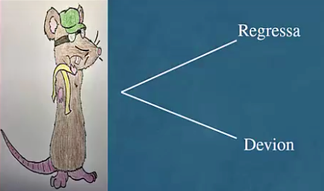
Probability Tree (1)
When a vehicle is purchased the Statista Motors customer must first choose between a Regressa and a Devion.

Slide 7
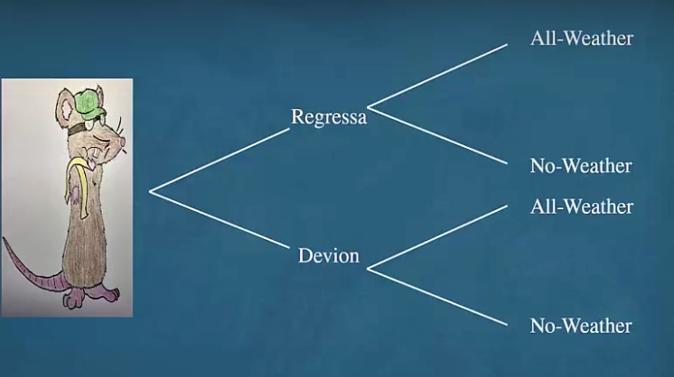
Probability Tree (2)
Once the vehicle is chosen the customer must choose between the All-Weather floor mats and the No-Weather floor mats. He must make this choice whether he purchases a Regressa or a Devion.

Slide 8
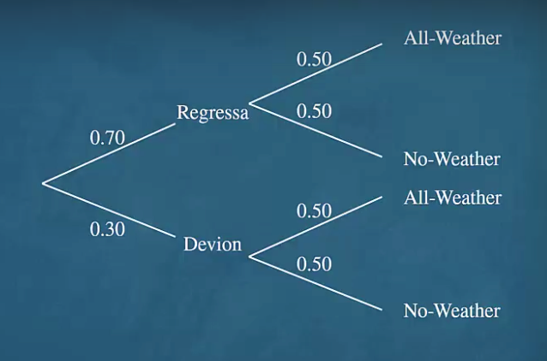
Probability Tree (3)
Let's assign probabilities to each branch of the tree.

Slide 9
Assign Probabilities
Probabilities were assigned to each branch of the tree on the previous slide. We are told that 70% of the vehicles sold by the company are Regressa models. The probability that a randomly selected customer purchases a Regressa is 0.70.
Using the concept of the complementary probability, the probability that the customer would purchase a Devion is 0.30.
Since floor Mat choice is independent of vehicle model selection and both floor mat types are equally likely to be selected. The probabilities along each branch in this part of the tree would be 0.50.

Slide 10
Assign Symbols
R - Represent the event that a Regressa is purchased
D – Represent the event that a Devion is purchased
A – Represent the event that All-Weather mats are chosen
N - Represent the event that No-Weather mats are chosen.

Slide 11

More Examples (1)
The original question was if a customer is selected at random find the probability that a Regressa with All-Weather floor mats was purchased.
Recall that for independent events A and B the probability that both events A and B will occur is equal to the product of the probabilities that each will occur.
The probability that a Regressa with All-Weather floor mats was purchased would be expressed in probability notation as the probability that both events R and A will occur.
$$P\left(R and A\right)=P\left(R\right)∙P\left(A\right)=.70 ∗ .30= .35$$

Slide 12

More Examples (2)
Find the probability that a randomly selected customer would purchase a Regressa with No-Weather mats.
$$P\left(R and N\right)=P\left(R\right)∙P\left(N\right)=.70∙.50= .35$$
Find the probability that a customer will purchase a Devion with All-Weather mats.
$$P\left(D and A\right)=P\left(D\right)∙P\left(A\right)=.30∙.50=.15$$
Find the probability that a customer will purchase a Devion with No-Weather mats.
$$P\left(D and N\right)=P\left(D\right)∙P\left(N\right)=.30∙.50=.15$$
The sum of all the branch probabilities will always equal to 1.
. 35 + .35 + .15 + .15 = 1

Slide 13
Summary
In this PowerPoint we learned how to apply the Multiplication Rule for Independent Events.

